Slide 1
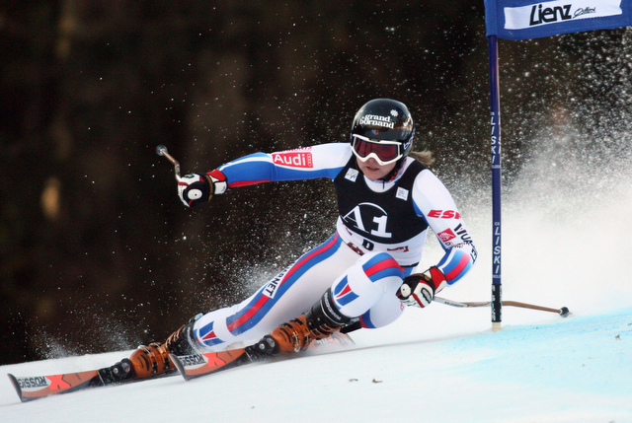
How much time are you leaving on the table?
Mark Holman

Slide 2
Leaving it on the Table
Simple definitions:
Rise Line
Fall Line

Slide 3
High Line
skis point a long distance out from gate
Skis cross Rise Line high above gate
Result: Clean carved turn, but slow due to skiing across fall line

Slide 4
Turning Early = Slow
1. Path if edges engaged
and pressured early
2. Actual Line
3. Skis pivot and skid
4. Edges engaged
5. Pressure builds
6. Turn complete

Slide 5
Getting it right: Direct Line
1. Skis pointed more down fall line (~6 ft. off turning gate)
Rise Line
2. Skis have been tipped to new edges early but are not actively pressured to initiate turn until rise line
3. Maximum edge angle and pressure achieved in fall line
4. Turn completed, skis release and accelerate downhill
Fall Line

Slide 6
Leaving it on the Table
High Line vs. Direct Line
How far can you push it?
The more direct the line, the longer you must delay initiation, and the tighter you must turn
How much time are you leaving on the table???

Slide 7
Leaving it on the Table

Slide 8
Leaving it on the Table

Slide 9
Late Line
Common mistake
Result: not only slow, but also late for the next gate
Skis cross Rise Line high above gate

